Slide 1
AVL Corporate Presentation
What’s new in C++ 14 and C++ 17
2017

Slide 2
What’s new in C++ 14 & 17 and what can we use?

Slide 3
C++ 14 – binary literals
#include <cassert>
int main()
{
int a = 0b1111;
int b = 0B1101;
assert(15 == a);
assert(13 == b);
return 0;
}

Slide 4
Inline namespace
namespace Avl {
namespace Rec {
inline namespace v1 {
struct Foo{};
}
namespace v2{
struct Foo{};
}
} }
int main()
{
Avl::Rec::Foo f; // default version
Avl::Rec::v2::Foo f2; // future version
}

Slide 5
Digits separators
#include <cstdint>
int main()
{
std::int64_t arte_time_ticks_in_sec = 10'000'000;
double pi = 3.141'592'653;
std::int64_t physical_addr = 0xCC'3D'82'A0'AB'9A;
std::uint16_t bit_mask = 0b111'0000'1111'0000;
}

Slide 6
C++ 14 Relaxed constexpr restrictions
Allow declarations within constexpr functions, other than
Static and thread_local variables
Uninitialized variables
Allow if and switch statements (but not goto)
Allow all looping statements
Allow mutation of objects whose liftime began within the constant expression functions.

Slide 7
C++ 14 Relaxed constexpr restrictions
constexpr int sumNaturalNum(unsigned int a)
{
int result = 0;
for (int i = 1; i <= a; ++i) {
result += i;
}
return result;
}
int main()
{
static_assert(6 == sumNaturalNum(3), ""); // EVALUATED AT COMPILE TIME
}

Slide 8
Deprecated attributes - functions
source.cpp(11): error C4996: 'f': function f is deprecated please use g
Be carefull: it was warning in Visual Studio 2015 as it should be.
It is now error in Visual Studio 2017
Needs to be disabled with compler switch /wd4996

Slide 9
Deprecated attributes - functions
[[deprecated("function f is deprecated please use g")]]
int f();
int f()
{
return 3;
}
int main()
{
auto r = f();
}

Slide 10
Deprecated attributes - variable
struct Foo {
int x = 0;
[[deprecated]] int y = 0;
};
int main()
{
Foo f;
f.x = 1;
f.y = 2;
int a[[deprecated]], b; // BUG IT SHOULD ONLY DEPRECATE a, GCC WORKS
// MSVC DEPRECATES BOTH a AND b, CLANG COMPILE ERROR b NOT DEFINED
a = 1;
b = 2;
}

Slide 11
Deprecate class / enums
struct [[deprecated("use class 'Whatever' it rocks")]]
Foo {
int x = 0;
int y = 0;
};
enum [[deprecated]] Enum1 { a, b, c };
enum class [[deprecated]] Enum2{ a, b, c };
int main()
{
Foo f;
Enum2 a;
}

Slide 12
Deprecate typedefs/ specializations
[[deprecated]]
typedef int myInt;
template <typename T>
class some_type {};
template<>
class [[deprecated]] some_type<int>
{ };
int main()
{
myInt a;
some_type<int> a; // DEPRECATED
some_type<short> b; // NOT DEPRECATED
}

Slide 13
Function return type deduction
auto SomeFunc(int);
If mutiple return expression are used in the funciton’s implementation, then they must all deduce same type. Functions that deduce their return type can be forward declared, but they cannot be used until they have been defined.
Their definition must be available to the translation unit that uses them

Slide 14
Function return type deduction
#include <iostream>
#include <type_traits>
auto SumNaturalNum(int i) {
if (i == 0) {
return 0;
}
return SumNaturalNum(i - 1) + i;
}
int main() {
auto sum3 = SumNaturalNum(3);
std::cout << sum3 << std::endl;
static_assert(std::is_same<int, decltype(SumNaturalNum(0))>::value, "");
return 0;
}

Slide 15
Function return type deduction - recursion
#include <iostream>
#include <type_traits>
auto SumNaturalNum(int i) {
if (i == 0) {
return 0; // MUST BE FIRST RETURN STATEMENT
}
return SumNaturalNum(i - 1) + i;
}
int main() {
auto sum3 = SumNaturalNum(3);
std::cout << sum3 << std::endl;
static_assert(std::is_same<int, decltype(SumNaturalNum(0))>::value, "");
return 0;
}

Slide 16
Generic lambdas
#include <numeric>
#include <iostream>
#include <vector>
int main()
{
using namespace std;
std::vector<int> a = { 44, 17, 33, 17, 32, 32, 44 };
// std::vector<long> a = ...
// std::vector<unsigned> a = ...;
auto result = accumulate(begin(a), end(a), 0,
[](auto a, auto b) { return a^b; }
);
cout << "element without duplicate: " << result << endl; // writes 33
return 0;
}

Slide 17
Lambda capture expressions
#include <memory>
#include <utility>
#include <iostream>
int main()
{
std::unique_ptr<int> p = std::make_unique<int>(2);
auto f = [local = std::move(p)] ()
{
std::cout << *local << std::endl;
};
f();
return 0;
}

Slide 18
Shared mutex – readers read in parallel
#include <thread>
#include <shared_mutex>
#include <iostream>
struct data {
data(int i) : m_i(i) {}
int read() const {
std::shared_lock<std::shared_mutex> lock(m_mtx);
return m_i;
}
int m_i;
mutable std::shared_mutex m_mtx;
};
int main() {
data d(1);
std::shared_lock<std::shared_mutex> guard(d.m_mtx);
std::thread thr([&d]() { std::cout << d.read() << std::endl; });
thr.join();
return 0;
}

Slide 19
Shared mutex – writers block readers and writers
struct data {
data(int i) : m_i(i) {}
int read() {
std::shared_lock<std::shared_mutex> lock(m_mtx);
return m_i;
}
int m_i;
mutable std::shared_mutex m_mtx;
};
int main() {
data d(1);
d.m_mtx.lock(); // std::unique_lock<std::shared_mutex> guard(d.m_mtx);
std::thread thr([&d]() { std::cout << d.read() << std::endl; });
d.m_i = 32;
using namespace std::literals;
std::this_thread::sleep_for(10s);
d.m_mtx.unlock();
thr.join();
return 0;
}

Slide 20
Standard defined literals – user defined literals
#include <iostream>
#include <cstdint>
#include <array>
constexpr std::size_t operator"" _KB(std::size_t kb) { return 1024 * kb; }
constexpr std::size_t operator"" _MB(std::size_t mb) { return 1024 * 1024 * mb; }
int main()
{
std::cout << "KB is " << 1_KB << " bytes" << std::endl;
std::cout << "MB is " << 1_MB << " bytes" << std::endl;
std::array<char, 4_KB> array; // used in compile time
return 0;
}

Slide 21
Standard defined literals
#include <string>
#include <chrono>
int main()
{
using namespace std::literals;
auto str = "Hello World"s;
static_assert(std::is_same_v<std::string, decltype(str)>, "");
auto min = 60s;
static_assert(
std::is_same_v<std::chrono::seconds, decltype(min)>, ""
);
}

Slide 22
Standard defined literals
operator""if operator""i operator""il | imaginary part of complex number
operator""h | A std::chrono::duration literal representing hours
operator""min | A std::chrono::duration literal representing minutes
operator""s | A std::chrono::duration literal representing seconds
operator""ms | A std::chrono::duration literal representing milliseconds
operator""us | A std::chrono::duration literal representing microseconds
operator""ns | A std::chrono::duration literal representing nanoseconds
operator""s | Converts a character array literal to basic_string

Slide 23
Variable templates
Constexpr variable templates define compile-time constants
Can be initialized or defined through recursion, with template-instantiation base class needed or throught constexpr functions
Overflow = compile error
Are always compile-time constants
Template instantiation computes value
template <typename T>
constexpr T pi = T(3.141'592'653'589'793L);

Slide 24
Compile time calculation before
#include <iostream>
template <size_t n >
struct fact {
static size_t const value{ (n > 1) ? n * fact<n - 1>::value : 1 };
};
template <>
struct fact<0> {
static size_t const value = 1;
};
int main()
{
std::cout << fact<5>::value << std::endl;
}

Slide 25
Compile time calculation with variable templates
#include <iostream>
template < size_t n >
constexpr size_t fact{ n * fact<n - 1> };
template <>
constexpr size_t fact<0>{1};
int main()
{
std::cout << fact<5> << std::endl;
return 0;
}

Slide 26
Using traits requires less typing
#include <type_traits>
template <typename T>
using remove_const_e = typename std::remove_const<T>::type;
int main()
{
typename std::remove_const<int const >::type a;
std::remove_const_t<const int> b;
remove_const_e<const int> c;
}

Slide 27
C++ 17
For visual studio one must add compiler flag /std:c++latest
Be prepared for: „ fatal error C1001: An internal error has occurred in the compiler.”

Slide 28
Nested namespace definitions - before
namespace avl {
namespace rcd {
class channel
{
std::string m_sys_name;
std::string m_lcl_name;
};
}
}
int main()
{
avl::rcd::channel ch;
}

Slide 29
Nested namespace definitions - after
namespace avl::rcd {
class channel
{
std::string m_sys_name;
std::string m_lcl_name;
};
}
int main()
{
avl::rcd::channel ch;
}

Slide 30
Structured bindings - before
#include <tuple>
#include <iostream>
int main()
{
std::tuple<int, const char*> t = std::make_tuple(2, "Hello");
// binding result from function that returns multiple values
auto number = std::get<0>(t);
auto msg = std::get<1>(t);
// or
int num;
const char* message = nullptr;
std::tie(num, message) = t;
}

Slide 31
Structured bindings - after
#include <iostream>
struct Channel
{
long svHandle;
double frequency;
double typeId;
};
Channel make_channel() { return Channel{ 1, 2.4, 2 }; }
int main()
{
auto[handle, freq, typeId] = make_channel();
std::cout << "h:" << handle << " freq: " << freq << " type: " << typeId << '\n';
return 0;
};

Slide 32
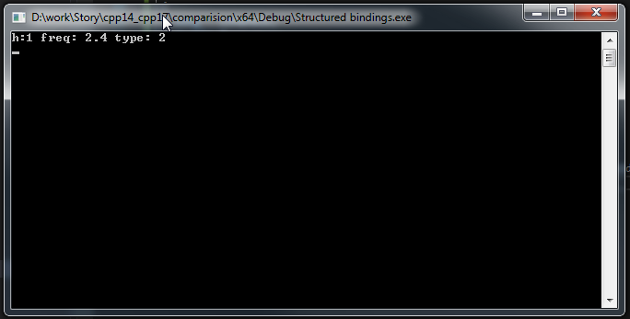
Structured bindings - after
#include <iostream>
struct Channel
{
long svHandle;
double frequency;
double typeId;
};
Channel make_channel() { return Channel{ 1, 2.4, 2 }; }
int main()
{
auto[handle, freq, typeId] = make_channel();
std::cout << "h:" << handle << " freq: " << freq << " type: " << typeId << '\n';
return 0;
};

Slide 33
Structured bindings
Standard classes that support strucured binding:
pair
tuple
array
int main()
{
float point[] = { 2.f, 4.f, 5.f };
auto& [x, y, z] = point;
}

Slide 34
Structured bindings
auto [a,b,...] = obj;
The type of obj must be Destructurable:
Either all non-static data members:
Must be public
Must be direct members of the type or members of the same public base class of the type
Cannot be anonymous unions.
Or the type has:
An obj.get<> method or ADL get<> overload.
Specializations of std::tuple_size<> and std::tuple_ement<>

Slide 35
Selection statements with initializers
{
init;
if (condition)
{
}
else
{
}
}
if (init; condition)
{
}
else
{
}
Equivalent to:

Slide 36
Selection statements with initializers - example
namespace avl::rec {
struct states_desc
{
std::string desc(int stateCode);
private:
mutable std::shared_mutex m_mtx;
std::map<int, std::string> m_descs;
};
std::string states_desc::desc(int stateCode)
{
if (std::shared_lock<std::shared_mutex> lock(m_mtx); !m_descs.empty())
{
if (auto it = m_descs.find(stateCode); it != m_descs.end()) return (*it).second;
return "";
}
// TODO load from mlg string from mlg file
}
}

Slide 37
Selection statements with initializers - example
namespace avl::rec {
struct states_desc
{
std::string desc(int stateCode);
private:
mutable std::shared_mutex m_mtx;
std::map<int, std::string> m_descs;
};
std::string states_desc::desc(int stateCode)
{
if (std::shared_lock<std::shared_mutex> lock(m_mtx); !m_descs.empty())
{
if (auto it = m_descs.find(stateCode); it != m_descs.end()) return (*it).second;
return "";
}
// TODO load from mlg string from mlg
}
}
Read mutex only locks the if statement
Iterator is only accessible when it make sense

Slide 38
Compile time conditional statements - example
class Channel
{
public:
Channel(std::string const& name, std::string lcl_name, long handle, double freq)
: m_sys_name(name)
, m_lcl_name(lcl_name)
, m_handle(handle)
, m_frequency(freq)
{ }
std::string& sys_name() { return m_sys_name; }
std::string& lcl_name() { return m_lcl_name; }
long& handle() { return m_handle; }
double& frequency() { return m_frequency; }
private:
std::string m_sys_name;
std::string m_lcl_name;
long m_handle;
double m_frequency;
};

Slide 39
Compile time conditional statements - example
class Channel
{
public:
Channel(std::string const& name, std::string lcl_name, long handle, double freq)
: m_sys_name(name)
, m_lcl_name(lcl_name)
, m_handle(handle)
, m_frequency(freq)
{ }
std::string& sys_name() { return m_sys_name; }
std::string& lcl_name() { return m_lcl_name; }
long& handle() { return m_handle; }
double& frequency() { return m_frequency; }
private:
std::string m_sys_name;
std::string m_lcl_name;
long m_handle;
double m_frequency;
};
Requirement: users want to use structural binding for our class channel.
But our class doesn’t have public data members !!!

Slide 40
Compile time conditional statements - example
First we need to provide specializations for tuple_size and tuple_element
namespace std {
template <>
struct tuple_size<Channel> : std::integral_constant<std::size_t, 4> {};
template <> struct std::tuple_element<0, ::Channel> { using type = std::string; };
template <> struct std::tuple_element<1, ::Channel> { using type = std::string; };
template <> struct std::tuple_element<2, ::Channel> { using type = long; };
template <> struct std::tuple_element<3, ::Channel> { using type = double; };
}

Slide 41
Compile time conditional statements - example
Than we need to provide get functions
template <std::size_t I>
auto& get(Channel ch);
template <> auto& get<0>(Channel ch) {
return ch.sys_name();
}
template <> auto& get<1>(Channel ch) {
return ch.lcl_name();
}
template <> auto& get<2>(Channel ch) {
return ch.handle();
}
template <> auto& get<3>(Channel ch) {
return ch.frequency();
}

Slide 42
Compile time conditional statements - example
Or a better way
template <std::size_t I >
auto& get(Channel ch)
{
if constexpr (I == 0) return ch.sys_name();
else if constexpr (I == 1) return ch.lcl_name();
else if constexpr (I == 2) return ch.handle();
else if constexpr (I == 3) return ch.frequency();
}

Slide 43
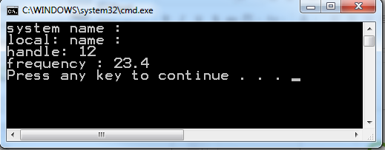
Compile time conditional statements - example
From user perspective
int main()
{
auto [sys_name, lcl_name, handle, freq] = make_channel();
std::cout << "system name : " << sys_name << std::endl;
std::cout << "local: name : " << lcl_name << std::endl;
std::cout << "handle: " << handle << std::endl;
std::cout << "frequency : " << freq << std::endl;
return 0;
}

Slide 44
Class template deduction
#include <thread>
#include <mutex>
std::mutex g_mtx;
struct
{
void do_work() {}
} g_data;
int main() {
std::thread thr([]() {
std::unique_lock<std::mutex> lck(g_mtx);
g_data.do_work();
});
thr.join();
return 0;
}
#include <thread>
#include <mutex>
std::mutex g_mtx;
struct
{
void do_work() {}
} g_data;
int main() {
std::thread thr([]() {
std::unique_lock lck(g_mtx);
g_data.do_work();
});
thr.join();
return 0;
}

Slide 45
Class template deduction
Does not work in visual studio
There is possibility to create deduction guides to help compiler to resolve type
namespace std
{
template <typename It>
vector(It b, It e)->vector<typename std::iterator_traits<It>::value_type>;
}

Slide 46
Auto non–type parameters
template <typename T, T v>
struct value
{
static constexpr T val = v;
};
int main() {
using i = value<int, 2048>;
using c = value<char, 'a'>;
using b = value<bool, true>;
}
template <auto v>
struct value
{
static constexpr auto val = v;
};
int main() {
using i = value<2048>;
using c = value<'a'>;
using b = value<true>;
}
Currently not supported

Slide 47
Inline variables
Header.h
#pragma once
#include <string>
void* getAddress1();
void* getAddress2();
inline std::string g_name = "puma"; // IT IS NOW POSSIBLE TO DEFINE INLINE VARIABLES
#include "Header.h"
void* getAddress1(){
return &g_name;
}
Src1.cpp
#include "Header.h"
void* getAddress2(){
return &g_name;
}
Src2.cpp

Slide 48
Inline variables
main.cpp
#include "Header.h"
#include <cassert>
int main() {
assert(&g_name == getAddress1());
assert(&g_name == getAddress2());
return 0;
}
They may be defined in more than one traslation unit as long as the defintions are identical
An inline variable with external linkage
Must be declared inline in every translation unit
Has the same address in every traslation unit
Similar to msvc extension _declspec( selectany )

Slide 49
constexpr lambdas
int main()
{
auto add = [](int i, int j) constexpr
{
return i + j;
};
static_assert(5 == add(1, 4));
}

Slide 50
unary static_assert
It is now not required to provide error descripion in static_assert
static_assert(5 == add(1, 4), "values do not match");
static_assert(5 == add(1, 4))

Slide 51
Guaranteed copy elision
#include <mutex>
std::mutex gmtx;
auto grabGlobalLock()
{
return std::lock_guard<std::mutex>(gmtx);
}
int main()
{
auto lck = grabGlobalLock();
}
MSVC doesn’t support this feature both gcc 7.2 and clang 5.0 do

Slide 52
Preprocessor predicate for header testing
#if __has_include(<string_view>)
# include <string_view>
# define HAVE_STRING_VIEW 1
#elif __has_include(<experimental/string_view>)
# include <experimental/string_view>
# define HAVE_STRING_VIEW 1
# define HAVE_EXP_STRING_VIEW 1
#else
# define HAVE_STRING_VIEW 0
#endif

Slide 53
C++17 attributes - [[maybe_unused]]
#include <cassert>
bool get_result() { return true; }
void maybe_unused()
{
[[maybe_unused]] bool ok = get_result();
assert(ok);
}
int main()
{
maybe_unused();
}

Slide 54
C++17 attributes - [[fallthrough]]
#include <array>
void send(short *to, short *from, int count) {
int n = (count + 7) >> 3;
switch (count & 0b111) {
case 0: do {
*to = *from++; [[fallthrough]];
case 7: *to++ = *from++; [[fallthrough]];
case 6: *to++ = *from++; [[fallthrough]];
case 5: *to++ = *from++; [[fallthrough]];
case 4: *to++ = *from++; [[fallthrough]];
case 3: *to++ = *from++; [[fallthrough]];
case 2: *to++ = *from++; [[fallthrough]];
case 1: *to++ = *from++;
} while (--n > 0);
}
}
int main() {
std::array<short, 256> from; // do some intialization
std::array<short, 256> to;
send(std::data(to), std::data(from), from.size());
}

Slide 55
C++17 attributes - [[nodiscard]]
[[nodiscard]] HRESULT GetObject(IUnknown** pObject) {
*pObject = ...; // some code;
return *pObject ? S_OK : E_FAIL;
}
int main() {
IUnknown** ppUnk = nullptr;
GetObject(ppUnk);
// store *pUnk for later use
}
warning C4834: discarding return value of function with 'nodiscard' attribute

Slide 56
std::optional – bad example
#include <optional>
#include <iostream>
std::optional<int> maybe(bool hasValue)
{
return hasValue ? std::optional<int>{2} : std::nullopt;
}
int main() {
auto value = maybe(true);
auto empty = maybe(false);
std::cout << "value received is: " << *value << std::endl;
try {
const auto dummy = *empty; // THIS IS UNDEFINED ON EMTY OPTIONAL
std::cout << "empty optional value is: " << dummy << std::endl;
} catch (std::bad_optional_access const& ex) {
std::cout << ex.what() << std::endl;
}
return 0;
}

Slide 57
std::optional – fix with exception
#include <optional>
#include <iostream>
std::optional<int> maybe(bool hasValue)
{
return hasValue ? std::optional<int>{2} : std::nullopt;
}
int main() {
auto value = maybe(true);
auto empty = maybe(false);
std::cout << "value received is: " << *value << std::endl;
try {
const auto dummy = empty.value();
std::cout << "empty optional value is: " << dummy << std::endl;
} catch (std::bad_optional_access const& ex) {
std::cout << ex.what() << std::endl;
}
return 0;
}

Slide 58
std::optional – fix with branching
#include <optional>
#include <iostream>
std::optional<int> maybe(bool hasValue) {
return hasValue ? std::optional<int>{2} : std::nullopt;
}
int main() {
auto value = maybe(true);
auto empty = maybe(false);
std::cout << "value received is: " << *value << std::endl;
if (empty.has_value()) {
std::cout << "value: " << *empty << std::endl;
} else {
std::cout << "empty variant" << std::endl;
}
return 0;
}

Slide 59
std::any
#include <any>
#include <vector>
#include <iostream>
int main() {
std::vector<std::any> v;
v.push_back(std::string("some string"));
v.push_back(int(3));
v.push_back(3.3);
std::cout << std::any_cast<std::string>(v[0]).c_str() << std::endl;
std::cout << std::any_cast<int>(v[1]) << std::endl;
std::cout << std::any_cast<double>(v[2]) << std::endl;
}

Slide 60
std::any_cast – std::bad_any_cast
#include <any>
#include <iostream>
#include <string>
int main() {
using namespace std::string_literals;
std::any a = "Hello World"s;
try {
std::cout << std::any_cast<std::string&>(a) << std::endl;
}
catch (std::bad_any_cast const& ex) {
std::cout << "std::bad_any_cast " << ex.what() <<std::endl;
}
return 0;
}

Slide 61
std::any – type and has_value propreties
#include <any>
#include <iostream>
#include <string>
int main() {
using namespace std::string_literals;
std::any empty;
std::any a = "Hello World"s;
if (!empty.has_value()) { std::cout << "any empty is actualy empty\n"; }
std::cout << a.type().name() << std::endl;
// if any is empty type returns std::type_info of typeid(void)
return 0;
}

Slide 62
std::variant – motivating example
#include <variant>
#include <iostream>
#include <string>
int main()
{
std::variant<int, double, std::string> v;
v = 2;
std::cout << std::get<int>(v) << std::endl;
try
{
std::cout << std::get<std::string>(v) << std::endl;
} catch (std::bad_variant_access const& e) {
std::cerr << "unable to access string from variant: " << e.what() << '\n';
}
return 0;
}

Slide 63
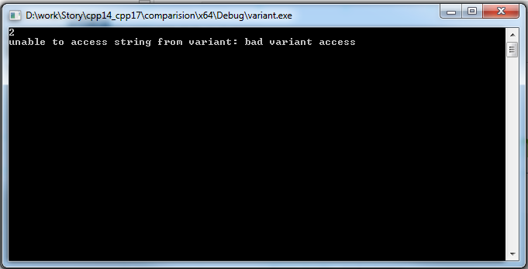
std::variant – motivating example
#include <variant>
#include <iostream>
#include <string>
int main()
{
std::variant<int, double, std::string> v;
v = 2;
std::cout << std::get<int>(v) << std::endl;
try
{
std::cout << std::get<std::string>(v) << std::endl;
} catch (std::bad_variant_access const& e) {
std::cerr << "unable to access string from variant: " << e.what() << '\n';
}
return 0;
}

Slide 64
std::variant - visiting
#include <variant>
#include <iostream>
#include <string>
struct variant_print {
variant_print(std::ostream& os) : m_os(os) {}
void operator()(int i) const { m_os << i; }
void operator()(double d) const { m_os << d; }
void operator()(std::string const& s) const { m_os << s; }
std::ostream& m_os;
};
int main() {
std::variant<int, double, std::string> v;
v = 2;
std::visit(variant_print{ std::cout } , v);
std::cout << '\n';
return 0;
}

Slide 65
std::variant – visiting with lambda
#include <variant>
#include <iostream>
#include <string>
#include <type_traits>
int main()
{
std::variant<int, double, std::string> v;
v = 2;
std::visit([] (auto const& v) {
using true_type = std::decay_t<decltype(v)>;
if constexpr (std::is_same_v<true_type, int >) std::cout << v;
if constexpr (std::is_same_v<true_type, double >) std::cout << v;
if constexpr (std::is_same_v<true_type, std::string>) std::cout << v;
}, v);
std::cout << '\n';
return 0;
}

Slide 66
std::string_view – motivating example
#include <string>
#include <iostream>
#include <memory>
void* operator new(std::size_t s) {
std::cout << " allocating memory " << s << std::endl;
return malloc(s);
}
void operator delete(void* p) {
std::cout << " deallocating memory" << std::endl;
free(p);
}
std::size_t length(std::string const& s) {
return s.size();
}
int main() {
std::cout << length("not so small string to avoid small object optimization") << std::endl;
return 0;
}

Slide 67
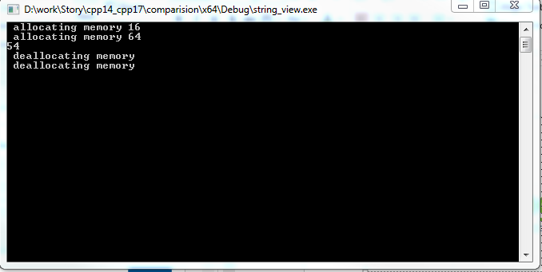
std::string_view – motivating example
#include <string>
#include <iostream>
#include <memory>
void* operator new(std::size_t s) {
std::cout << " allocating memory " << s << std::endl;
return malloc(s);
}
void operator delete(void* p) {
std::cout << " deallocating memory" << std::endl;
free(p);
}
std::size_t length(std::string const& s) {
return s.size();
}
int main() {
std::cout << length("not so small string to avoid small object optimization") << std::endl;
return 0;
}

Slide 68
std::string_view
#include <string>
#include <iostream>
#include <memory>
#include <string_view>
// same as before redefinition of operator new and operator delete
std::size_t length(std::string_view s) {
return s.size();
}
int main() {
std::cout << length("not so small string to avoid small object optimization");
return 0;
}

Slide 69
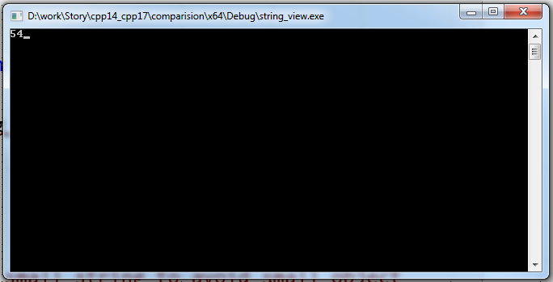
std::string_view
#include <string>
#include <iostream>
#include <memory>
#include <string_view>
// same as before redefinition of operator new and operator delete
std::size_t length(std::string_view s) {
return s.size();
}
int main() {
std::cout << length("not so small string to avoid small object optimization");
return 0;
}

Slide 70
std::string_view constructors and typedefs
constexpr basic_string_view() noexcept;
constexpr basic_string_view(const basic_string_view& other) noexcept = default;
constexpr basic_string_view(const CharT* s, size_type count);
constexpr basic_string_view(const CharT* s);
using string_view = basic_string_view<char>;
using u16string_view = basic_string_view<char16_t>;
using u32string_view = basic_string_view<char32_t>;
using wstring_view = basic_string_view<wchar_t>;

Slide 71
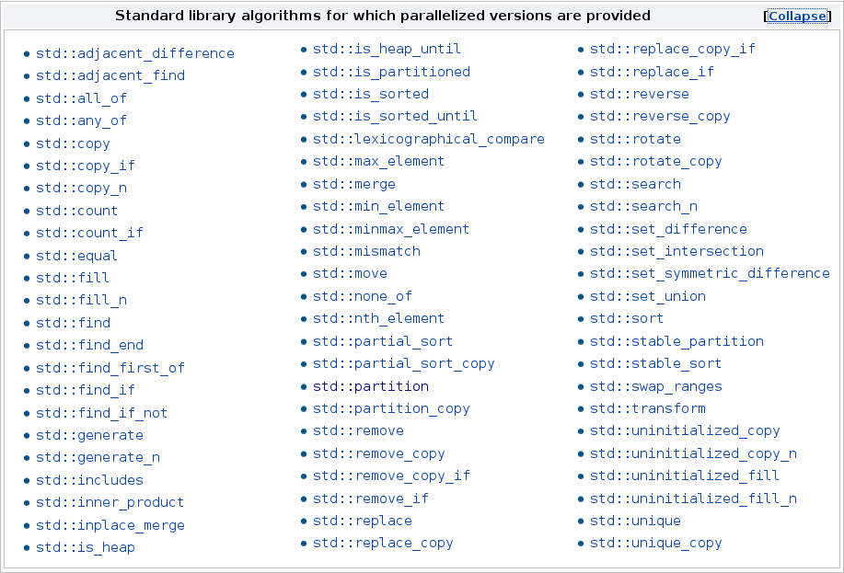
Parallel algorithms
69 of the algorithms of the STL support a parallel or a parallel and vectorized execution.

Slide 72
Parallel algorithms - execution policies
std::vector<int> v = { 1,2,4 };
// standard sequential sort
std::sort(v.begin(), v.end());
// sequential execution
std::sort(std::parallel::seq, v.begin(), v.end());
// permitting parallel execution
std::sort(std::parallel::par, v.begin(), v.end());
// permitting parallel and vectorized execution
std::sort(std::parallel::par_unseq, v.begin(), v.end());
For details please see attend upcomming Petra Krizan talk on parallel algorithms
Currently not supported in Visual Studio 2017.
If you want to play with it use implementation for following site:
https://stellar-group.github.io/hpx/docs/html/hpx/manual/parallel.html

Slide 73
Filesystem
include <filesystem>
Usual convention: namespace fs = std::filesystem
Interface is primarily non-member functions that operate on path objects
fs::path
fs::directory_entry and fs::directory_iterator
fs::file_status – file type and premissions
Major capabilities
Path creation/manipulation
Directory iterator and recursion
File/directory metadata query
File/directory creation, removal and modification

Slide 74
Polymorphic memory resources
include <memory_resource>
std::pmr::polymorphic_allocator is allocator that uses instances of std::pmr::memory_resource to acquire memory (it depends only on interface so it’s type doesn’t change when allocation strategy is changed
All STL allocator aware classes have their alias with polymorphic_allcator in pmr namespace
Standard provided memory resources:
std::pmr::new_delete_resource
std::pmr::unsynchronized_pool_resource
std::pmr::syncronized_pool_resource
std::pmr::monotonic_buffer_resource
Currently not supported in Visual Studio 2017

Slide 75
Mathematical special funcitons
associated Laguerre polynomials
beta function
(complete) elliptic integral of the first kind
(complete) elliptic integral of the second kind
(complete) elliptic integral of the third kind
regular modified cylindrical Bessel functions
cylindrical Bessel functions (of the first kind)
irregular modified cylindrical Bessel functions
cylindrical Neumann functions
(incomplete) elliptic integral of the first kind
(incomplete) elliptic integral of the second kind
(incomplete) elliptic integral of the third kind
exponential integral
Hermite polynomials
Legendre polynomials
Riemann zeta function
spherical Bessel functions (of the first kind)
spherical associated Legendre functions
spherical Neumann functions

